Slide 1
COMP-7150 Natural Language Processing Instructor: Salim Sazzed Department of Computer Science University of Memphis

Slide 2
Instructor: Salim Sazzed, PhD
– Office: Dunn Hall 131 – Phone: 757-275-5573
– Email: ssazzed@memphis.edu
– Office Hours: Wednesday, 2:15 PM – 3:15 PM (Dunn Hall 131)
- TA (N/A)
Research interests: Machine Learning, Natural Language Processing, Bioinformatics, Computer Vision.

Slide 3
Course Overview
In this course, we will mainly deal with natural language analysis/understanding (focusing on English language )
We focus on fundamental concepts, methods, models, and algorithms of natural language processing (NLP)
-Data (natural language): linguistic concepts and phenomena
-Representations: grammars, automata, etc. -Neural and statistical models over these representations
-Learning & inference algorithms for these models

Slide 4
Learning Outcome of the course
You should be able to answer the following questions:
-What makes natural language difficult for computers?
-What are the core NLP tasks? -What are the main techniques used to solve various NLP tasks?

Slide 5
What will you learn in this course?
In this course, you will learn about some of -
— the core tasks (as well as data sets and evaluation metrics) that people work on in NLP
— the fundamental models and algorithms that have been developed for these tasks
— the relevant linguistic concepts and phenomena that will be encountered in these tasks

Slide 6
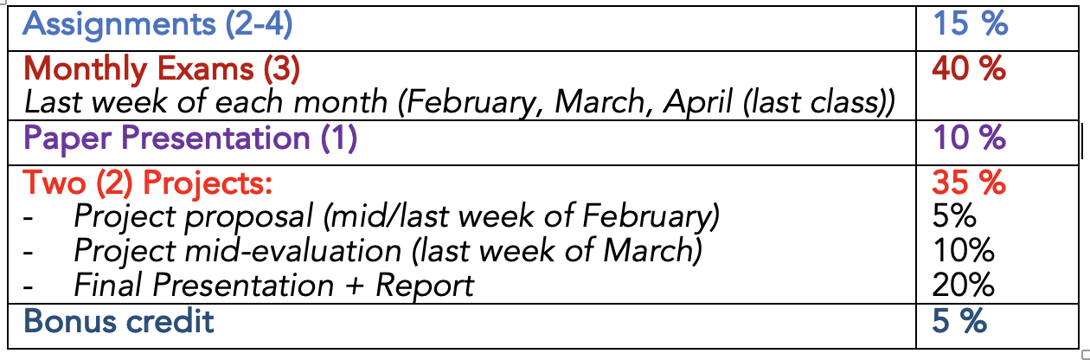
Grading:

Slide 7
Letter Grade:
A+ ≥ 96%
A ≥ 93%
A− ≥ 90%
B+ ≥ 85%
B ≥ 80%
B− ≥ 75%
C+ ≥ 70%
C ≥ 65%
C- ≥ 60,
Percentage below 60 will be failing grade (F).

Slide 8
Introduction to NLP
A fascinating intersection of linguistics and computer science.
Natural Language Processing (NLP) is a sub-field of artificial intelligence that focuses on the interaction between computers and human language.
It empowers machines to understand, interpret, and generate human-like text, enabling a range of applications from language translation to sentiment analysis.

Slide 9
Why NLP Matters
NLP plays a crucial role in bridging the gap between humans and machines.
From voice-activated assistants to language translation apps, NLP is at the core of many technologies we interact with daily.
Understanding its significance is key to appreciating the evolution of communication between humans and computers.

Slide 10
Key components
NLP encompasses several key aspects, including text preprocessing, language modeling, syntactic analysis, and semantic understanding.
These components work together to enable machines to comprehend the nuances of human language and extract meaningful insights.

Slide 11
Application of NLP in real-world scenarios

Slide 12
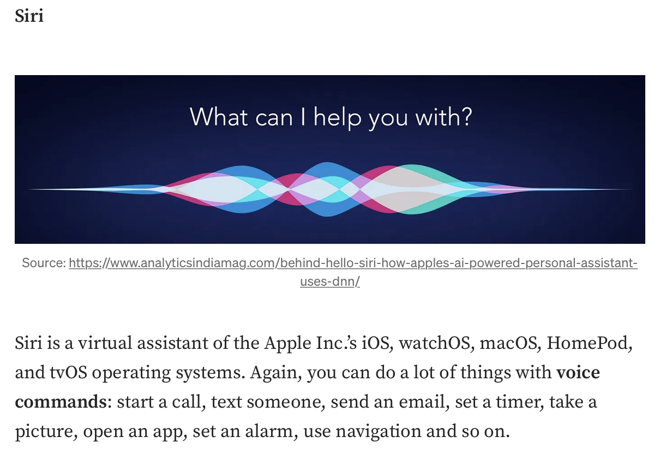
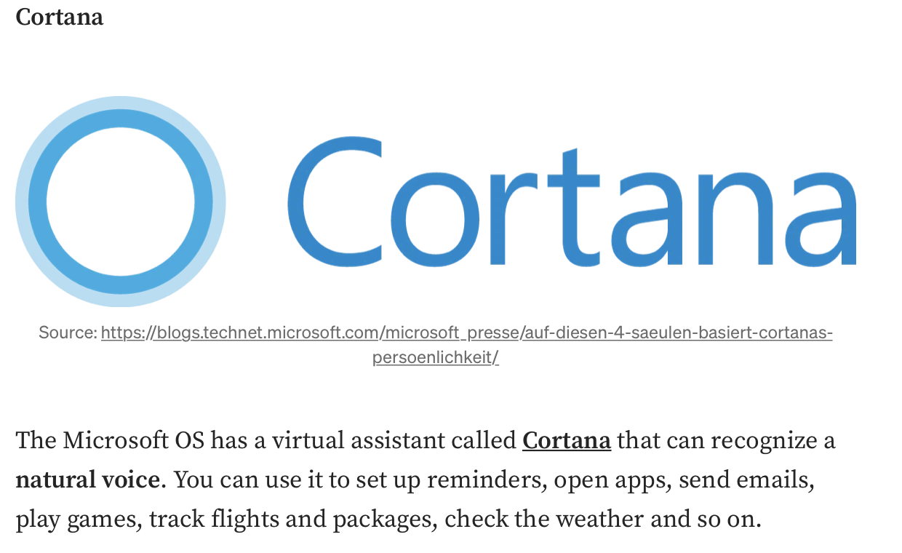
Virtual Assistant

Slide 13

Email Filters
# Spam or Not?
# Gmail further categories regular (non-spam) emails into three categories (primary, social, or promotions)
https://towardsdatascience.com/introduction-to-natural-language-processing-for-text-df845750fb63

Slide 14


Search Engine

Slide 15

Machine Translation

Slide 16
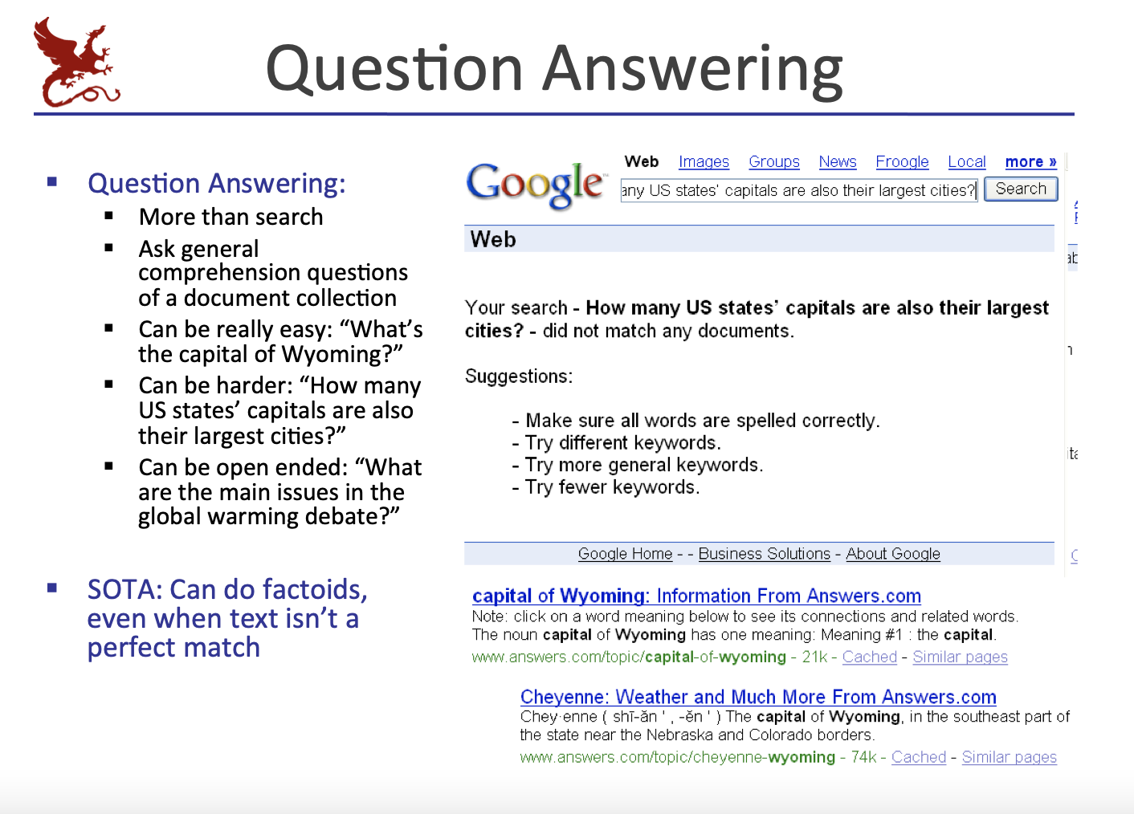

Slide 17
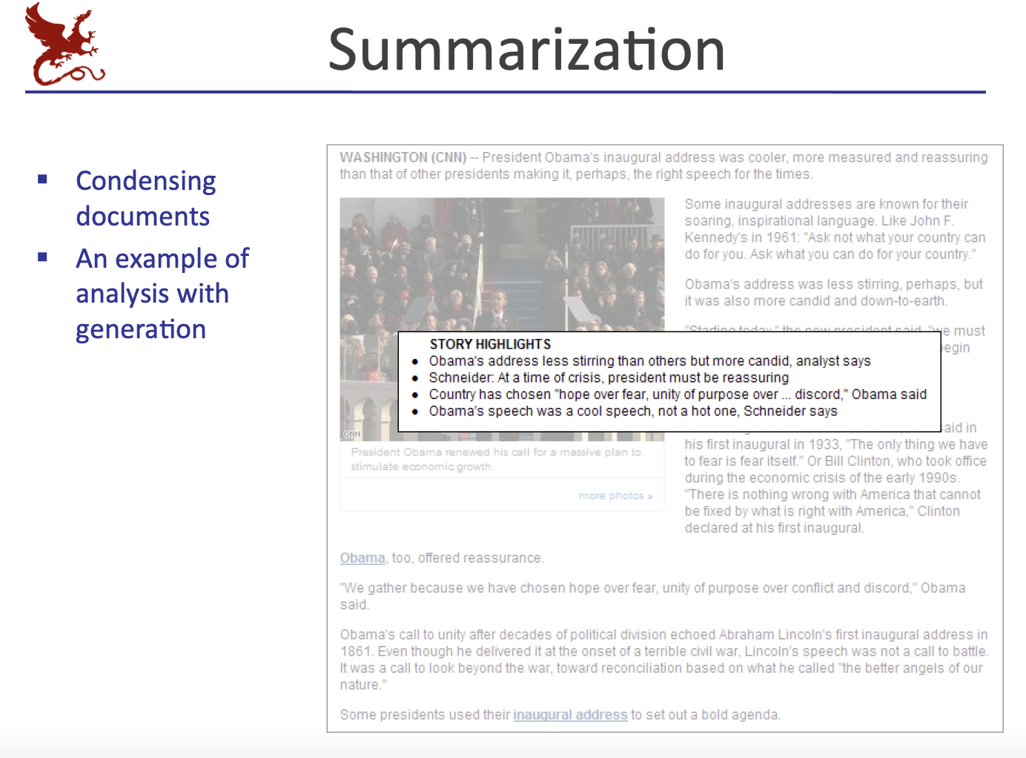

Slide 18
ChatGPT: Humanlike Conversational Agent
Artificial intelligence (AI) powered chatbot
Capable of humanlike conversational dialogue

Slide 19
